Slide 1

SQL REPORT
The supply chain data comes with 23 column and 2 column (Profit and Manufacturing cost to Price) were added during the course of the project.
There are different questions to be answered in this analysis which would require exposure to the topics mentioned below:
Aggregate Functions
Data Manipulation Language
Data Definition Language
Arithmetic (SQL Operators)
Group By & Order By Clause
Cast and Convert Function
Database Server used: MySQL
Supply Chain Project

Slide 2
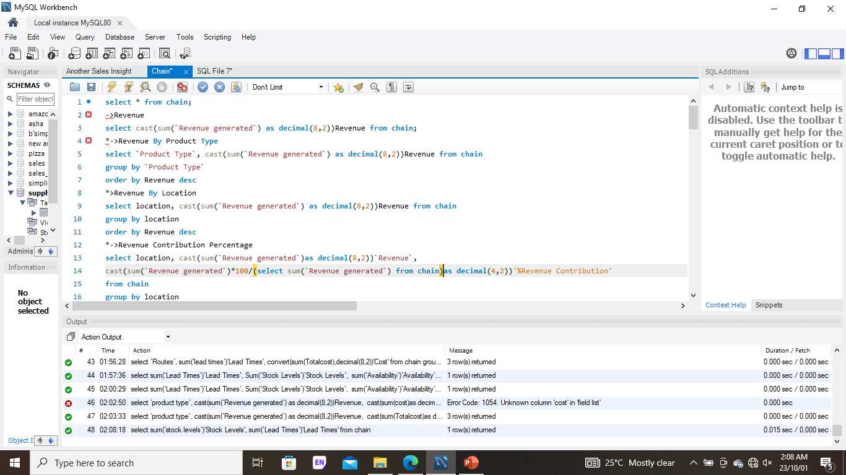
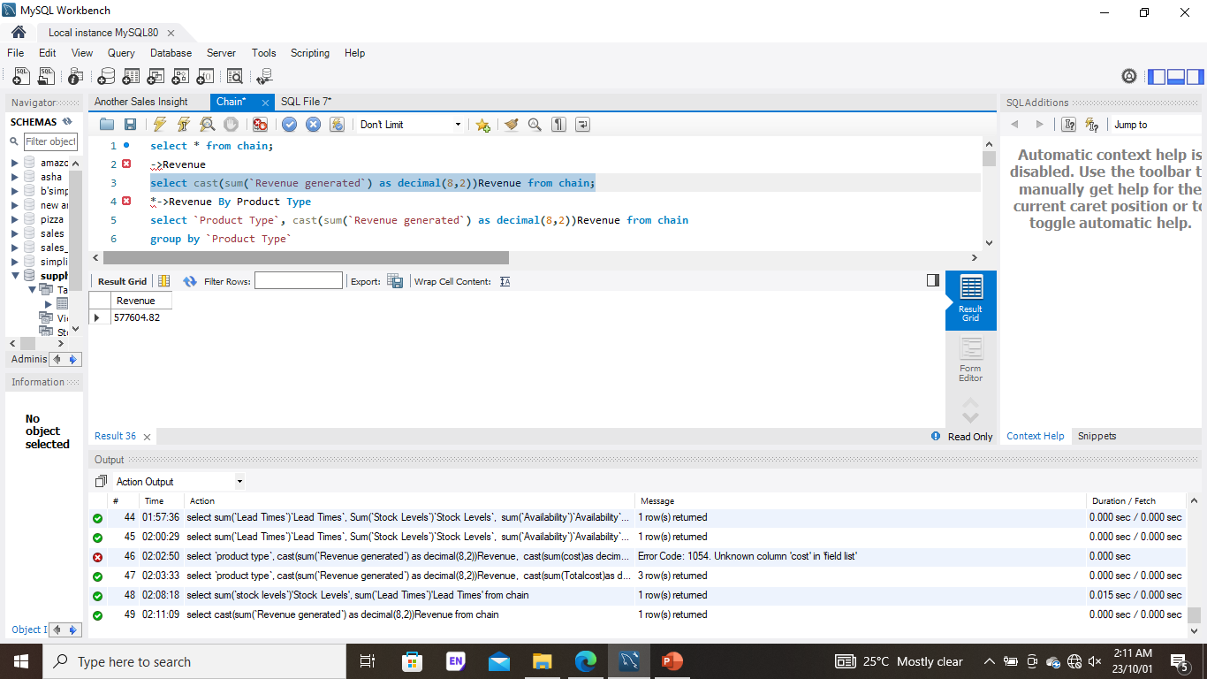
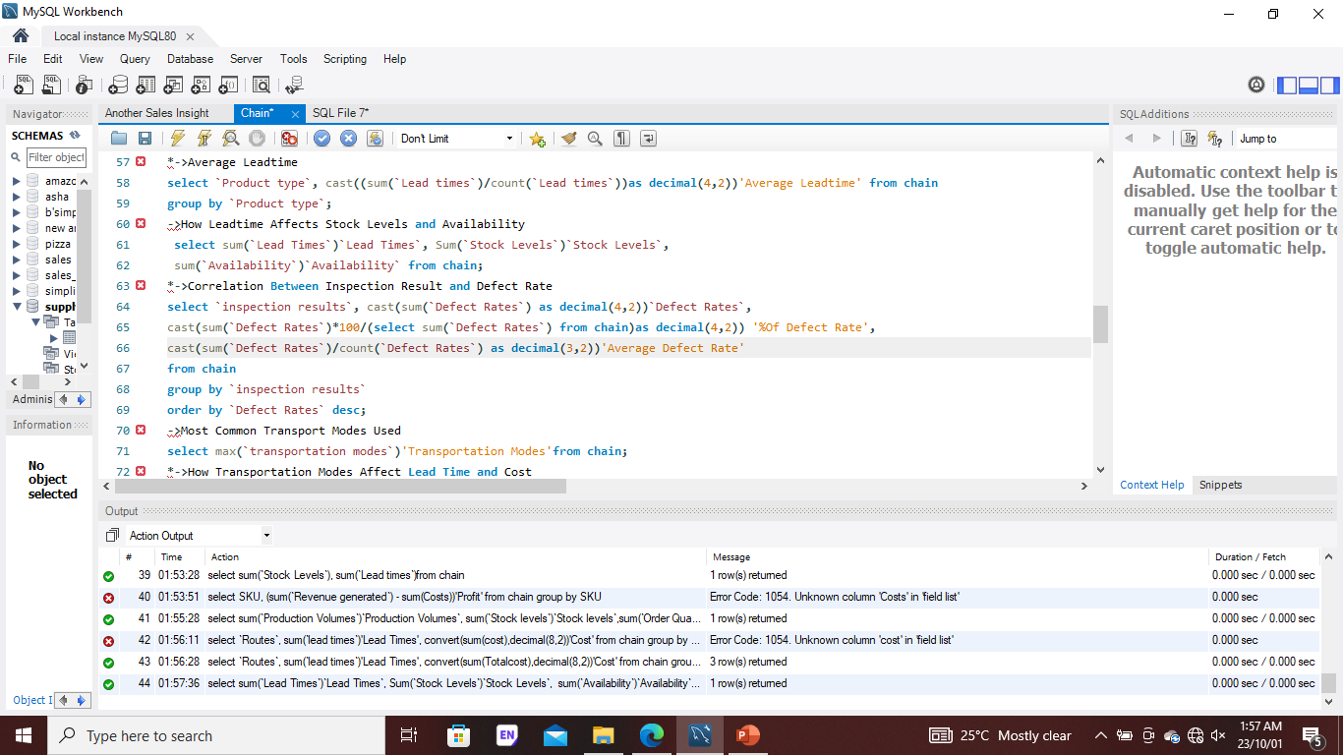
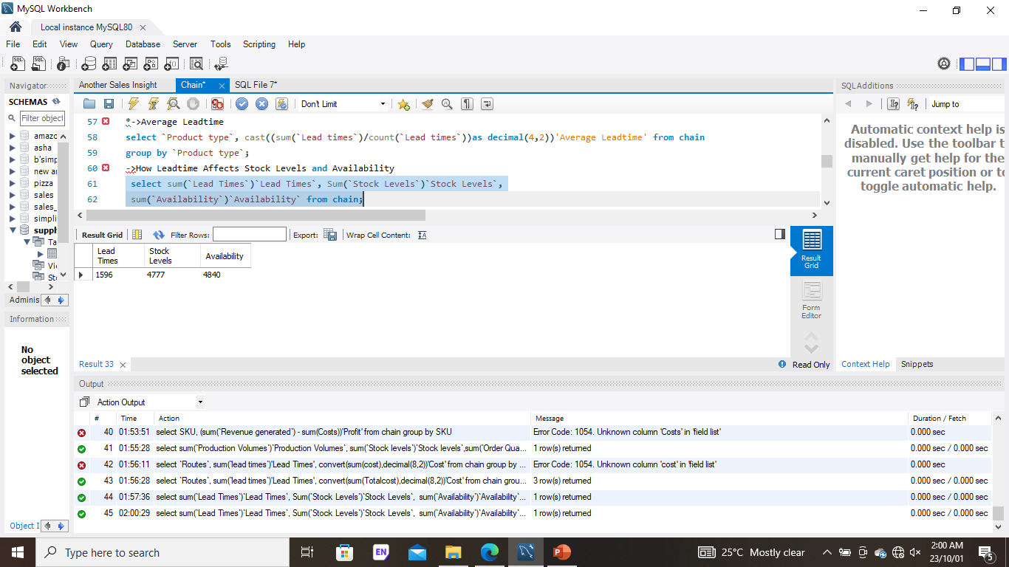

Slide 3
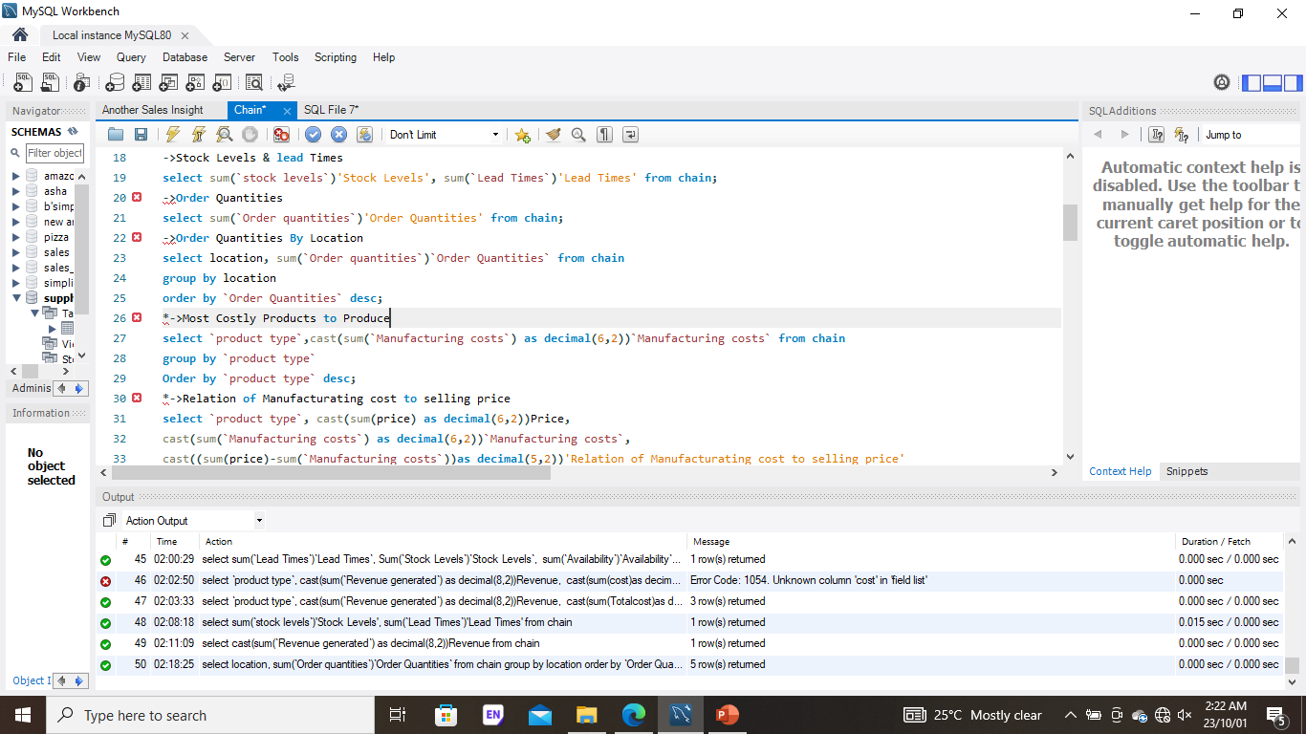
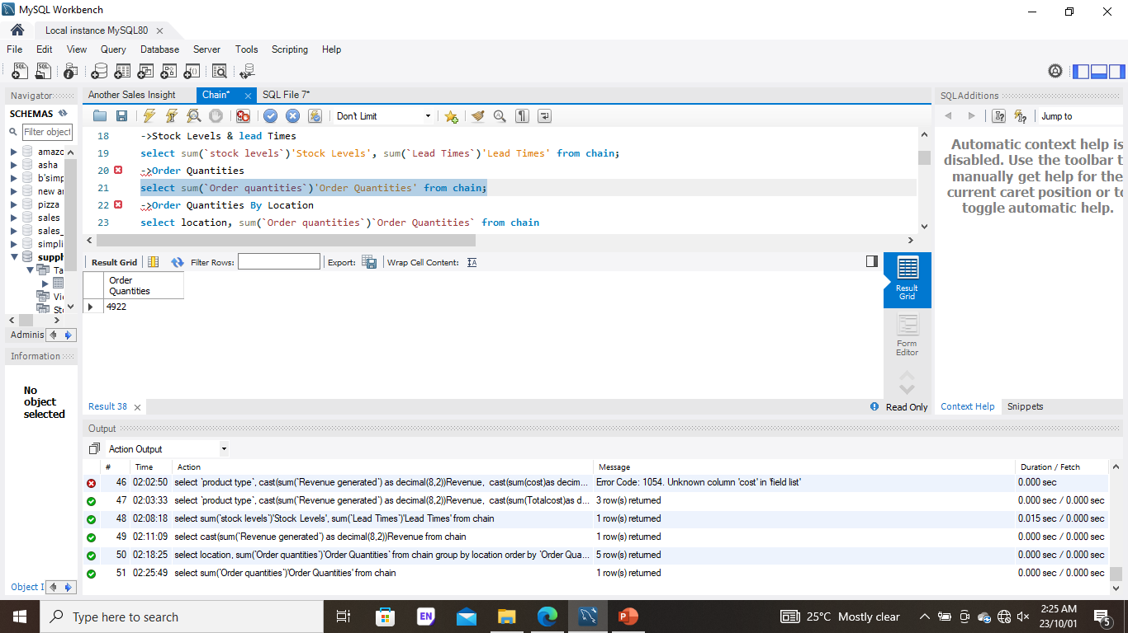
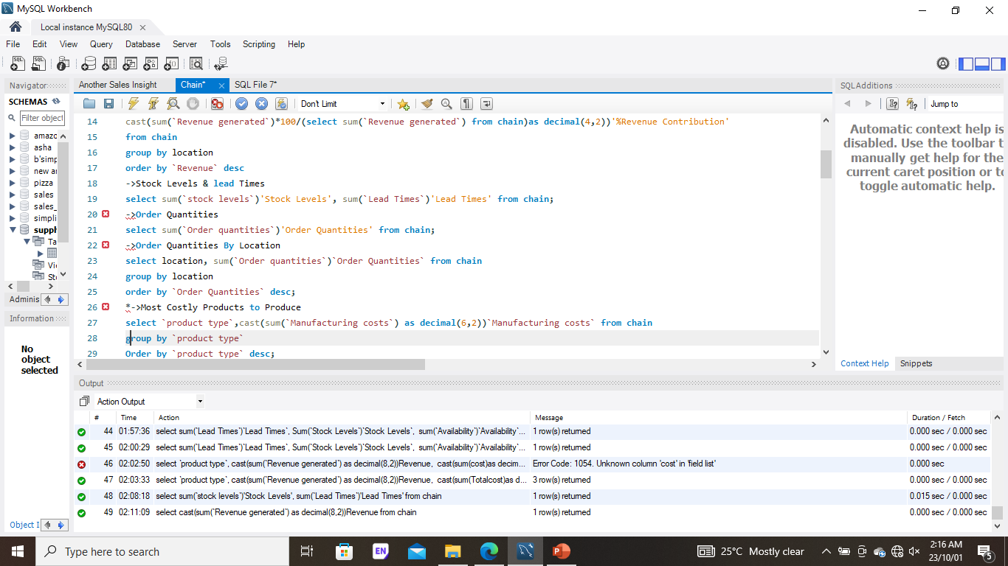
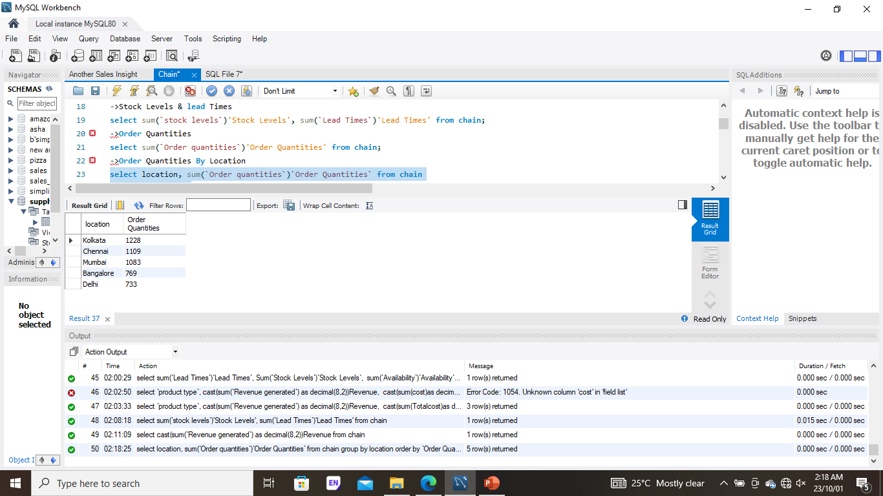

Slide 4
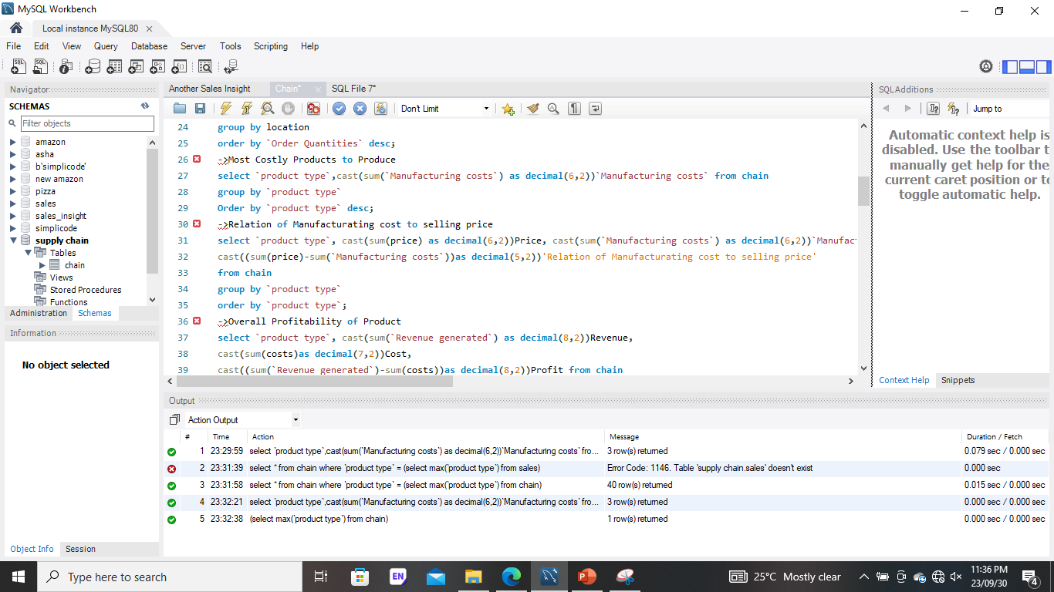
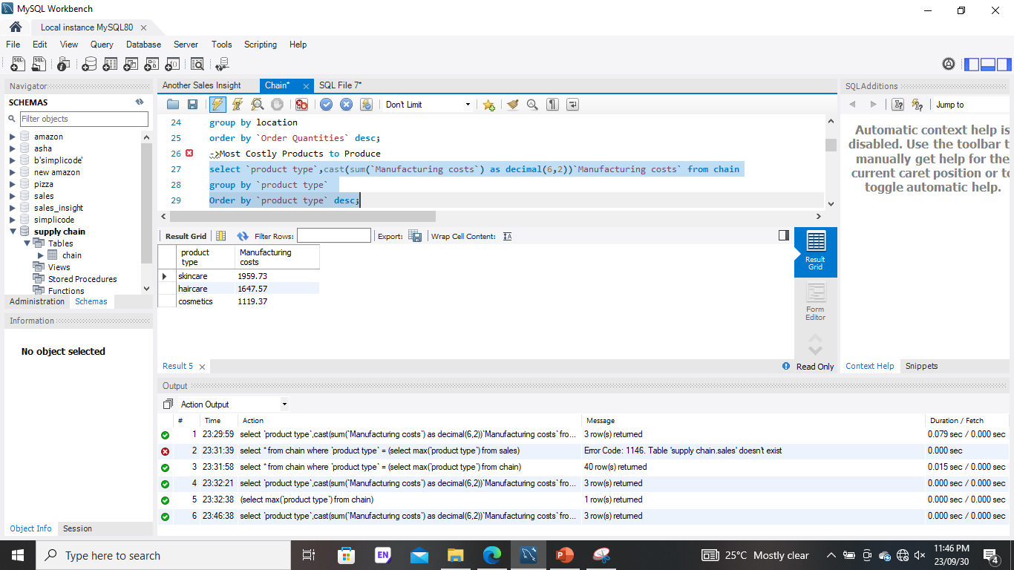

Slide 5
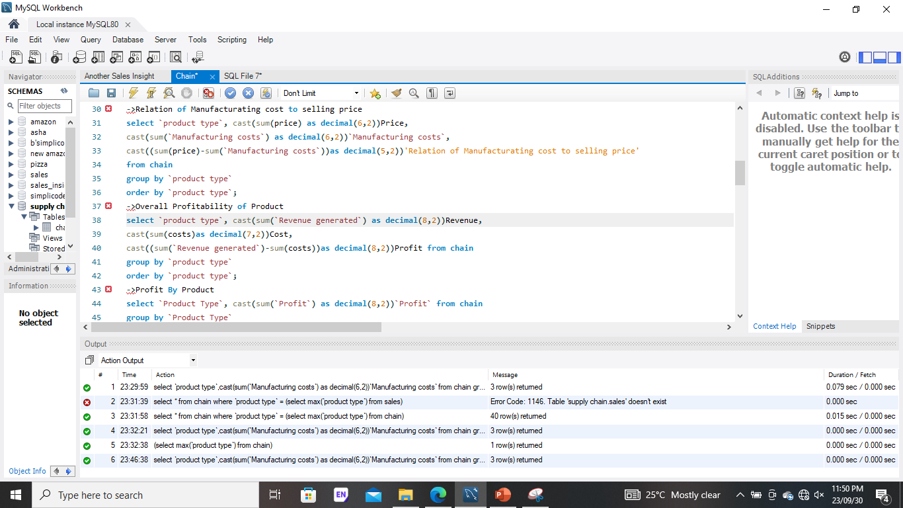
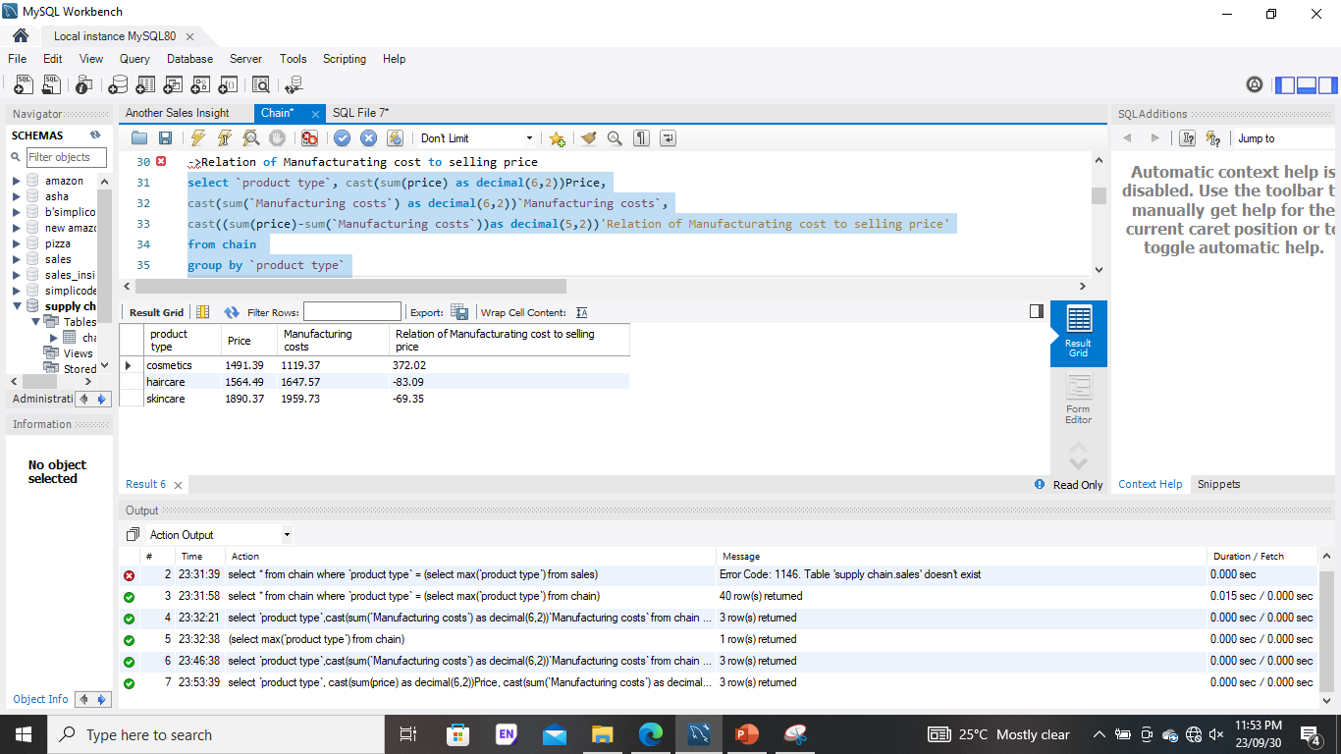

Slide 6
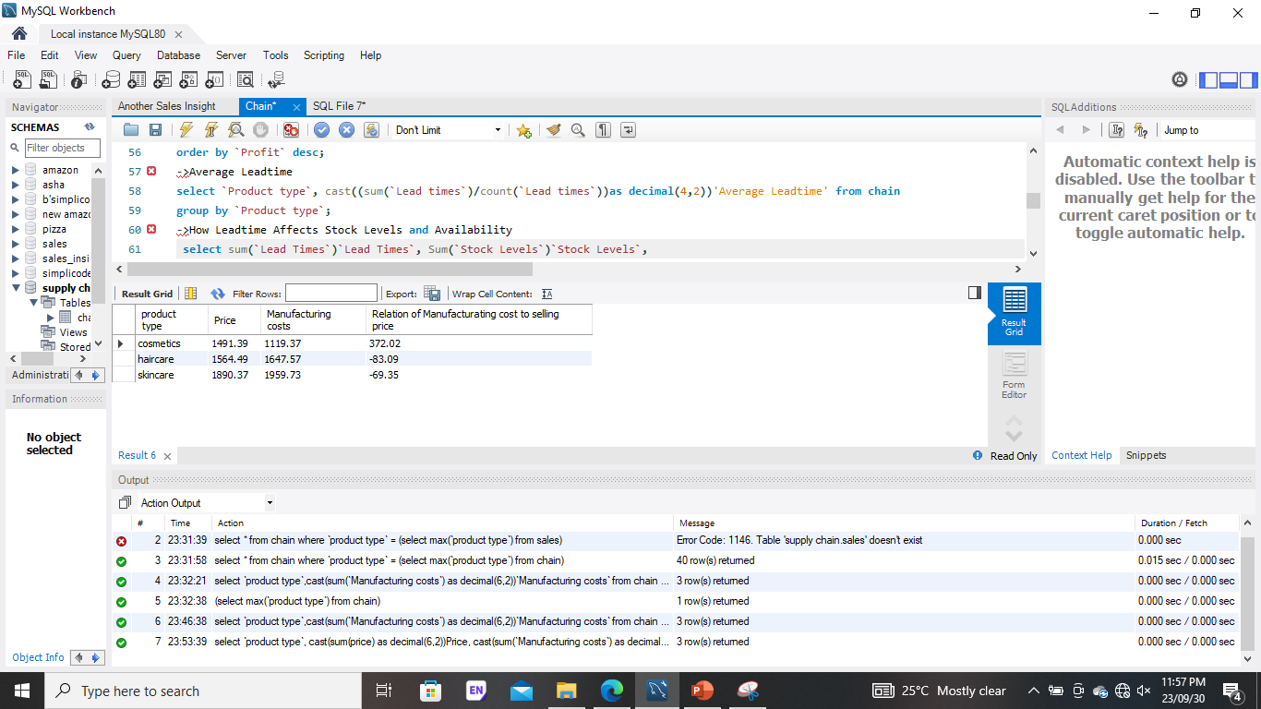
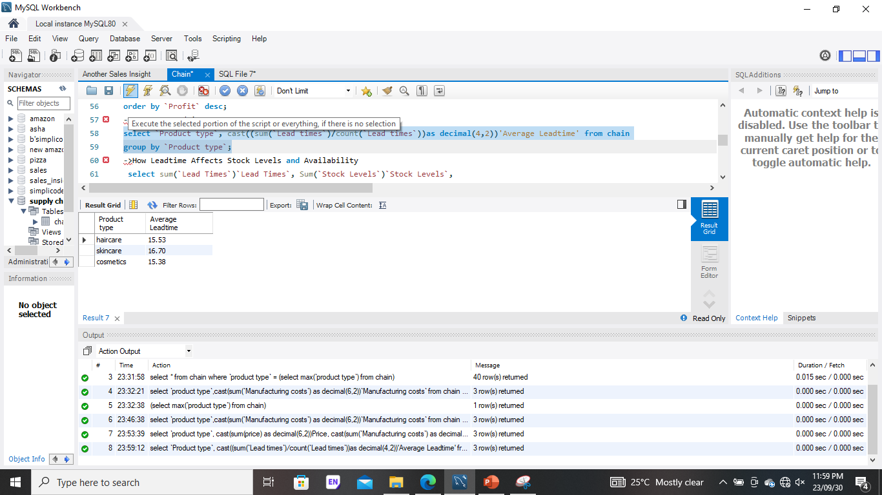

Slide 7
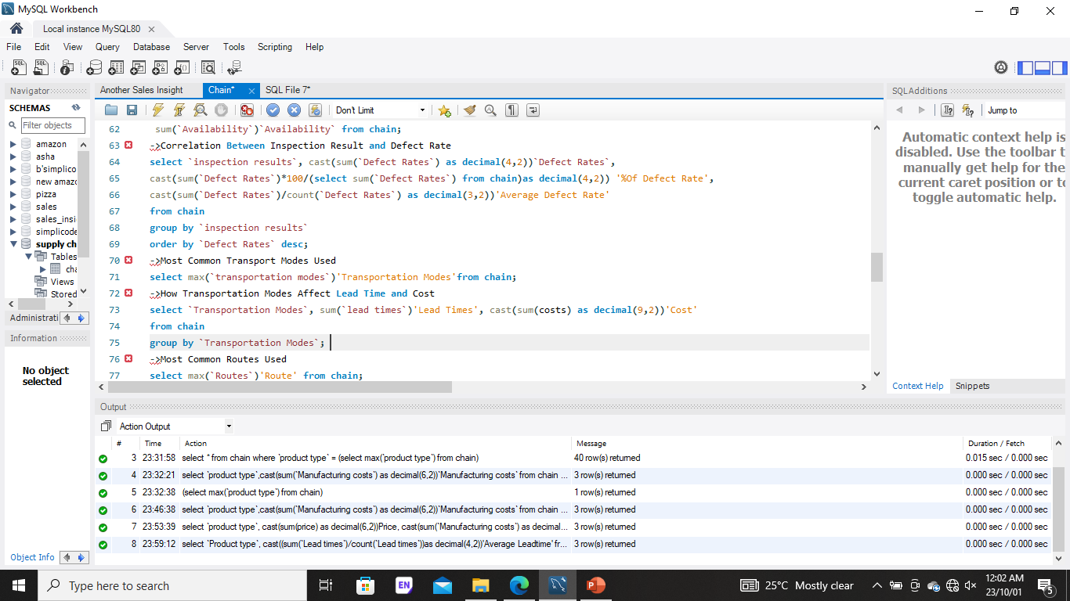
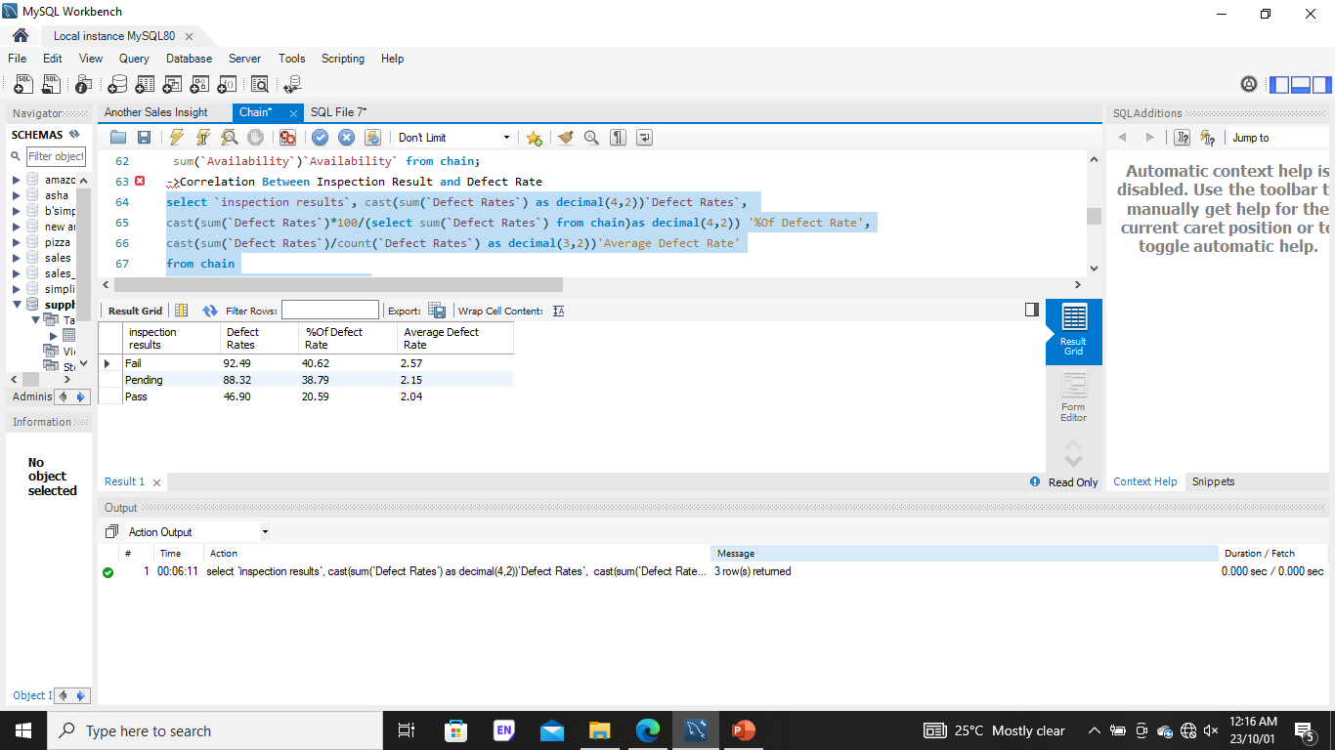

Slide 8
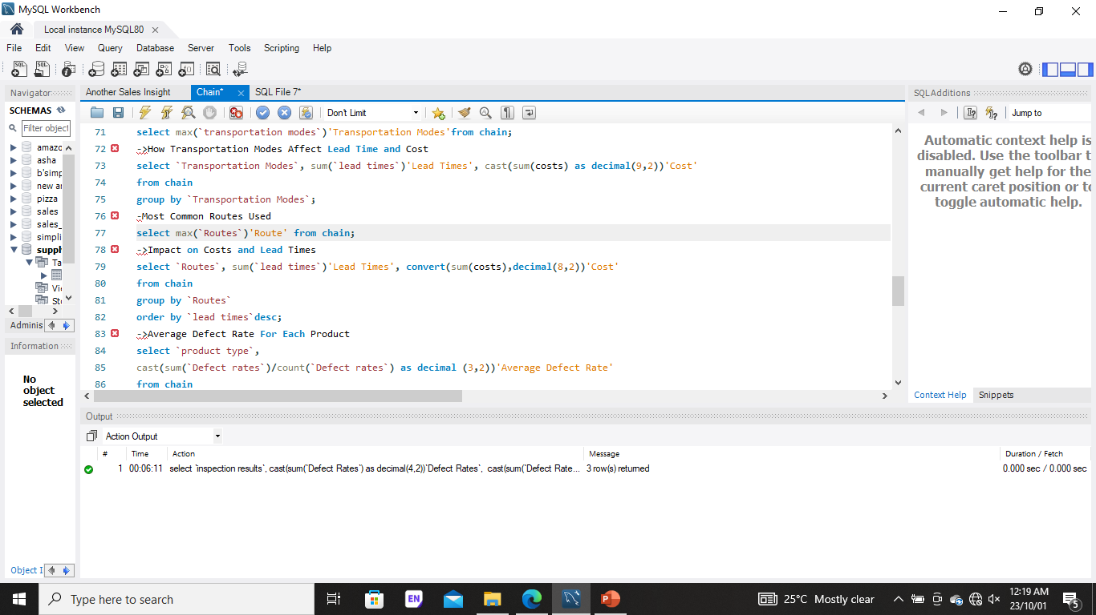
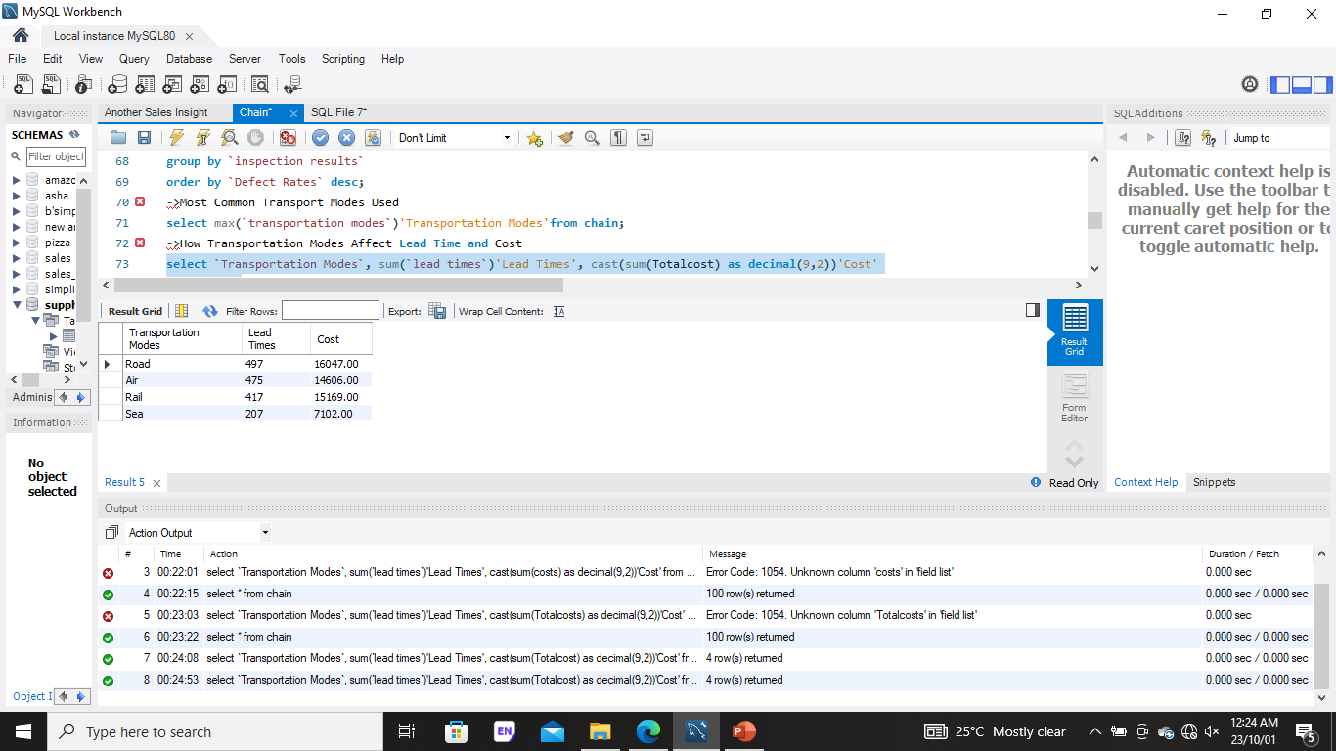

Slide 9
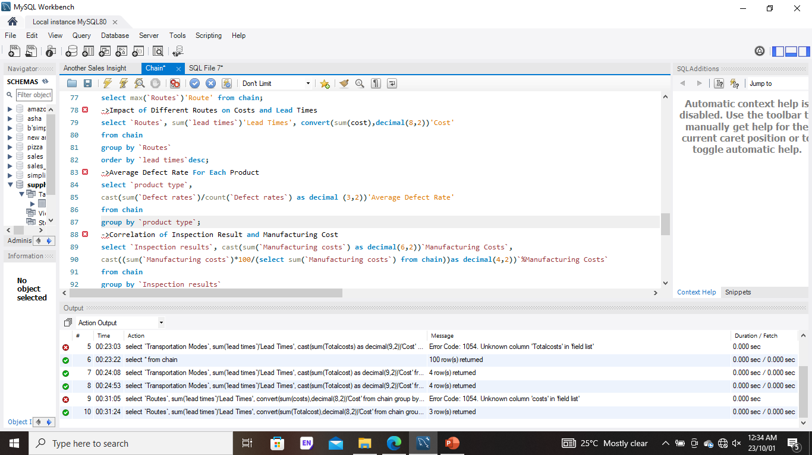
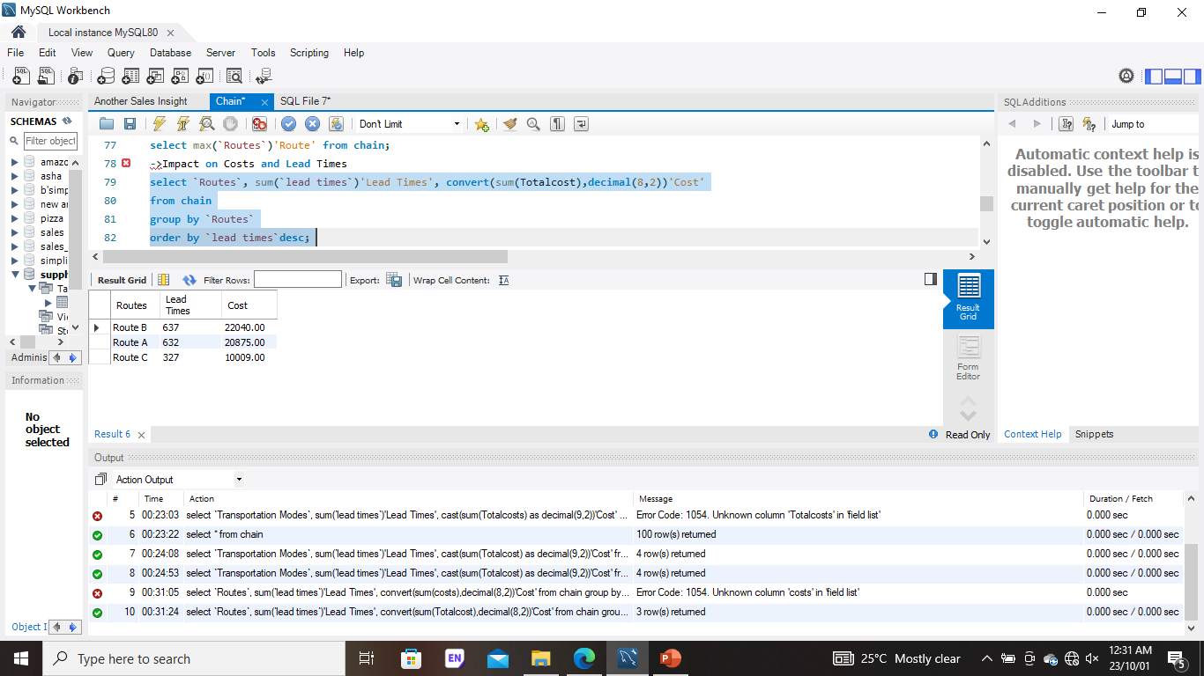

Slide 10
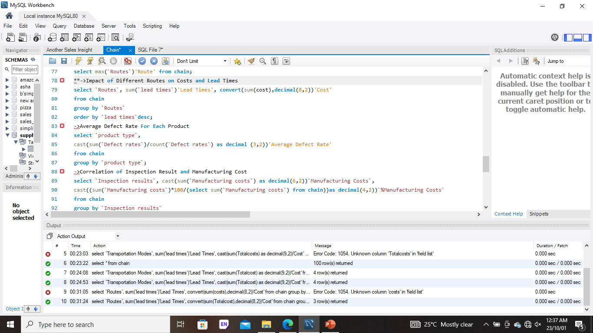
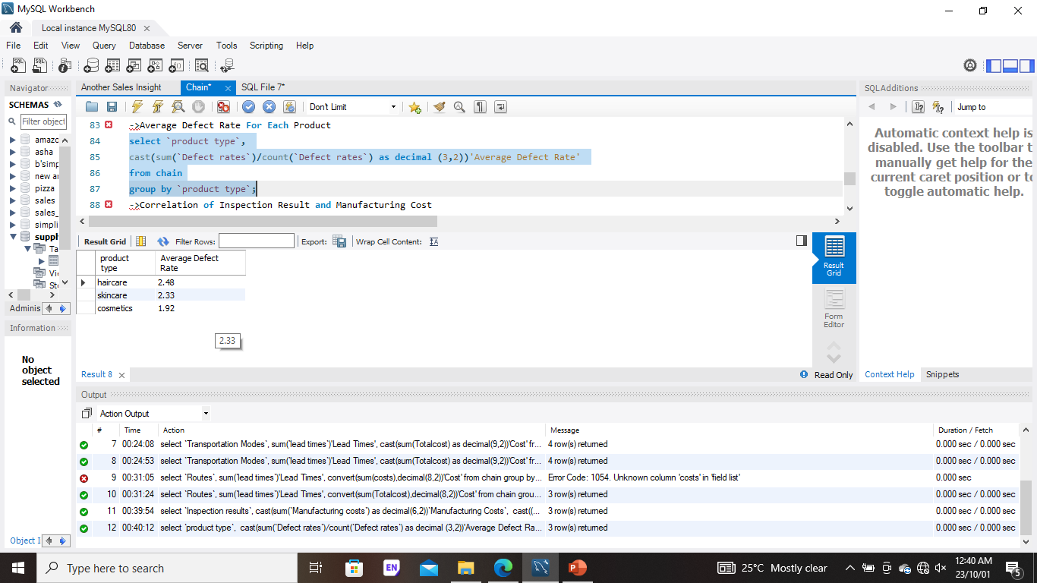

Slide 11
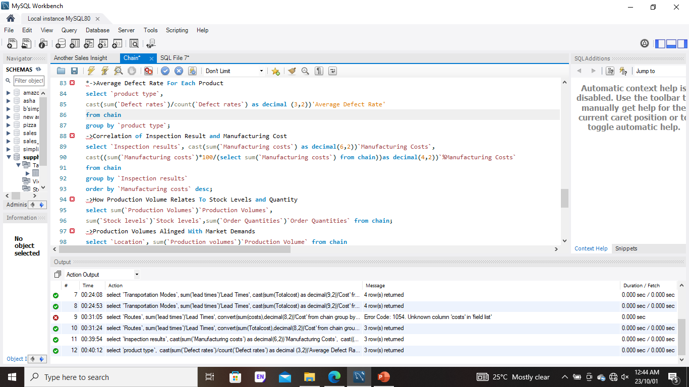
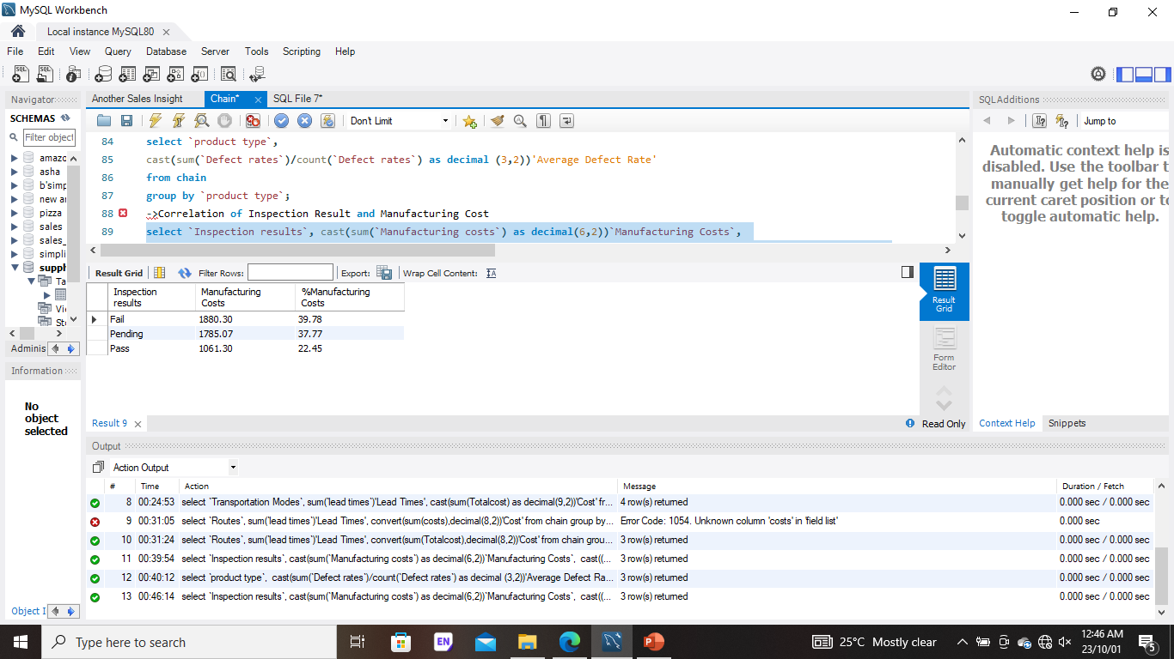

Slide 12
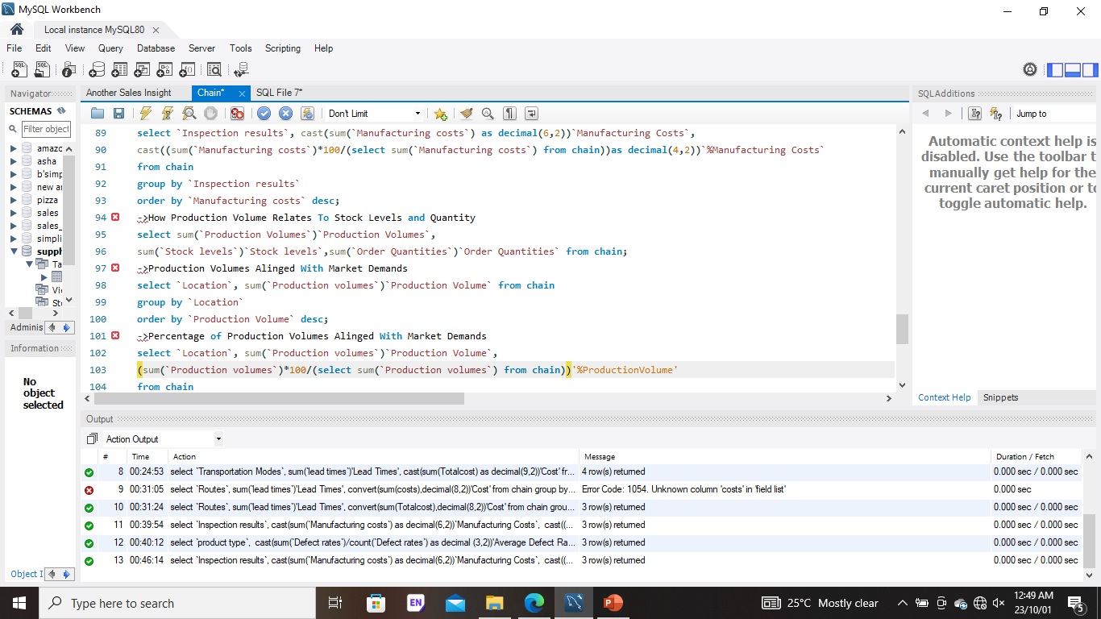
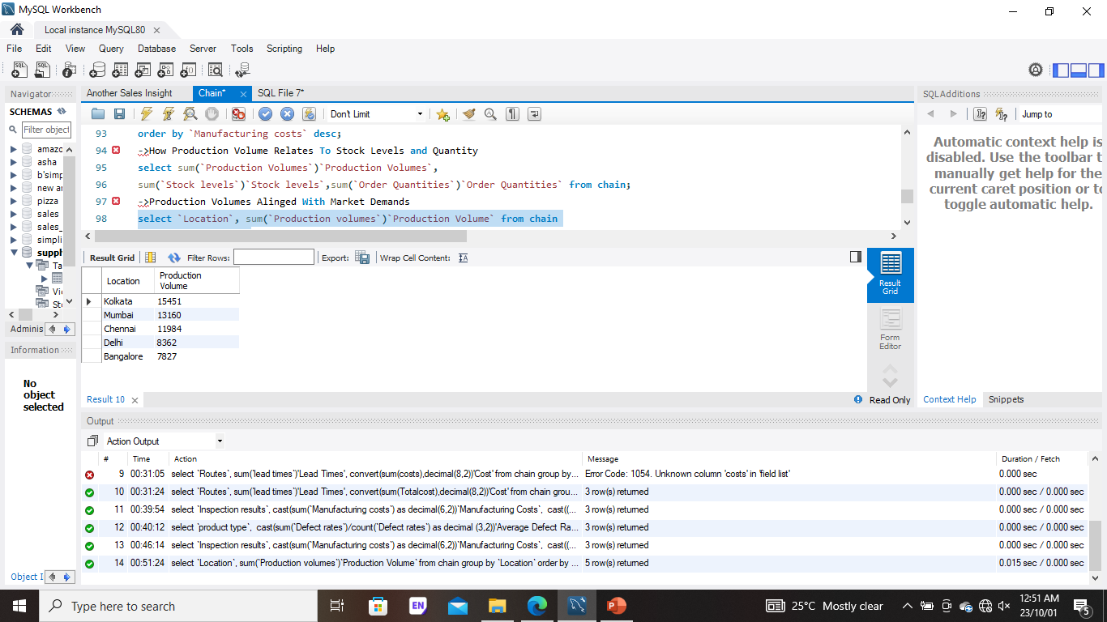

Slide 13
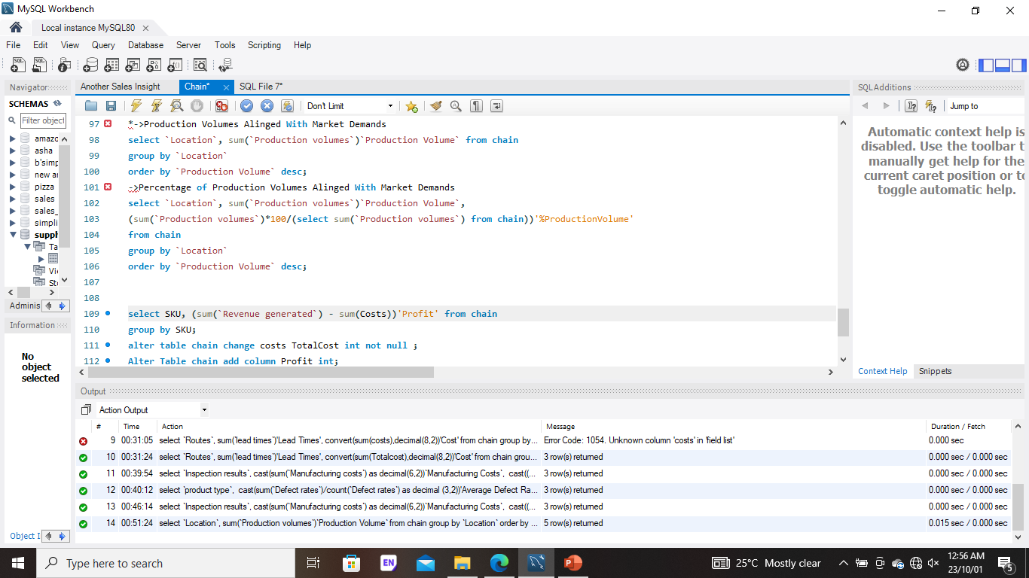


Slide 14
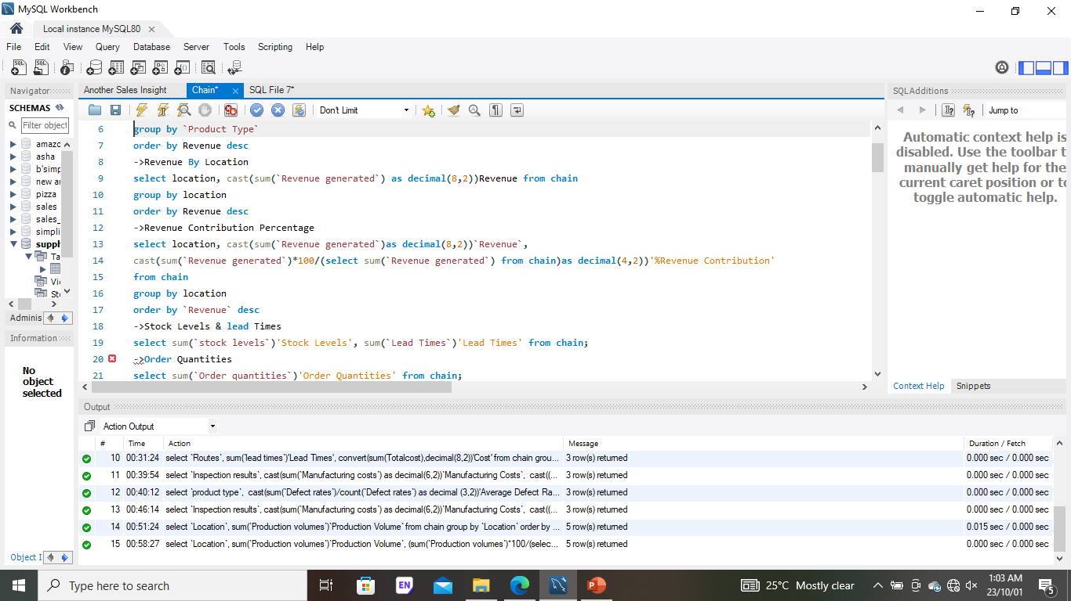
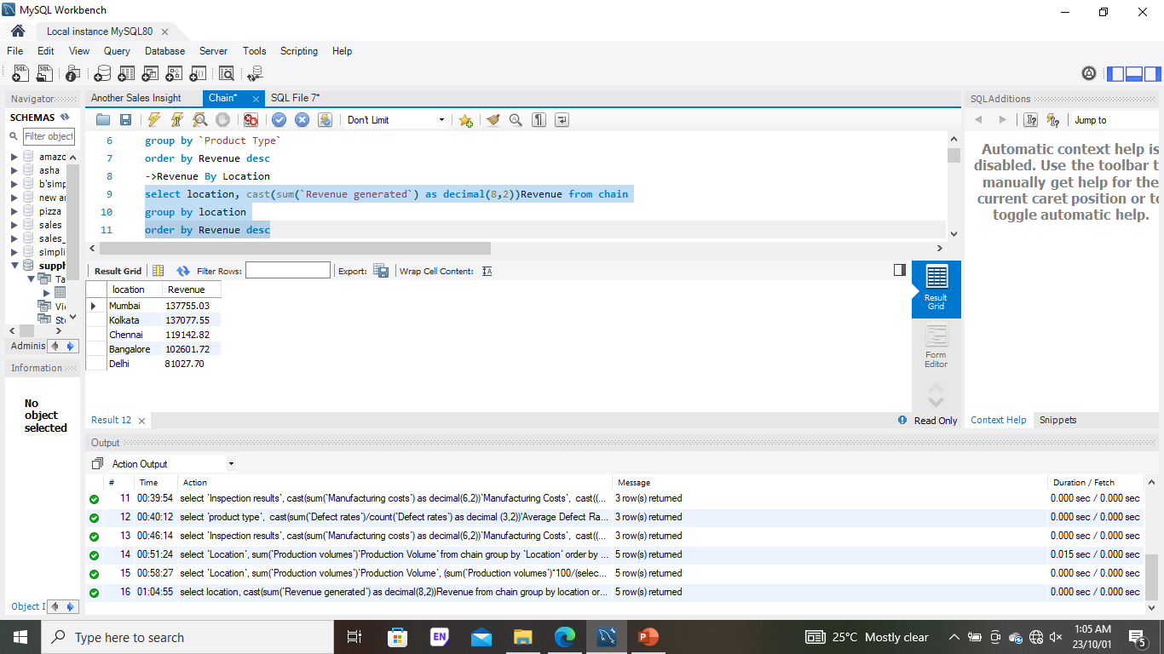

Slide 15
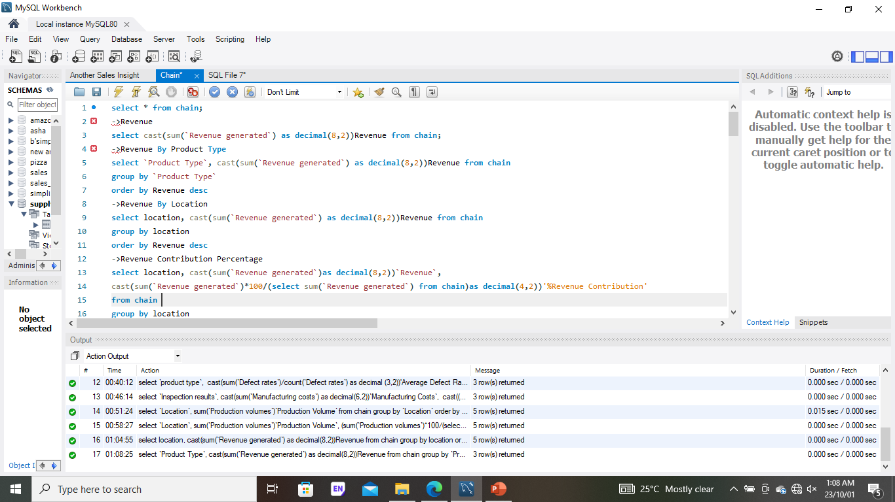
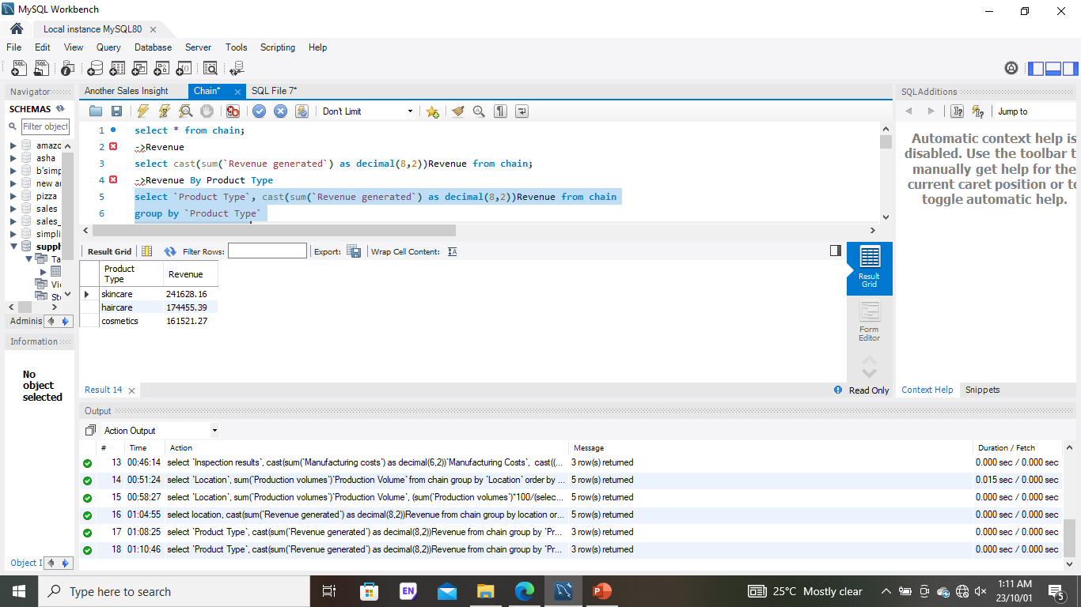

Slide 16
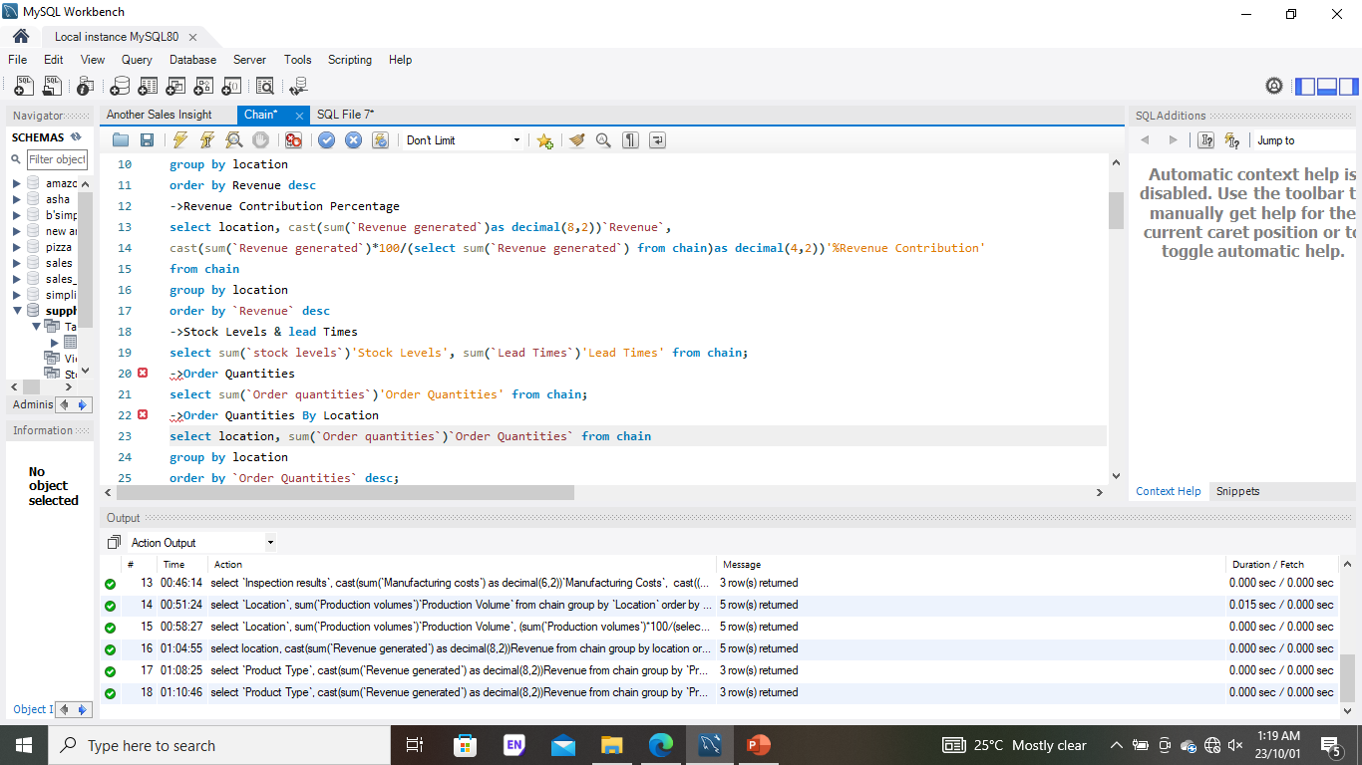
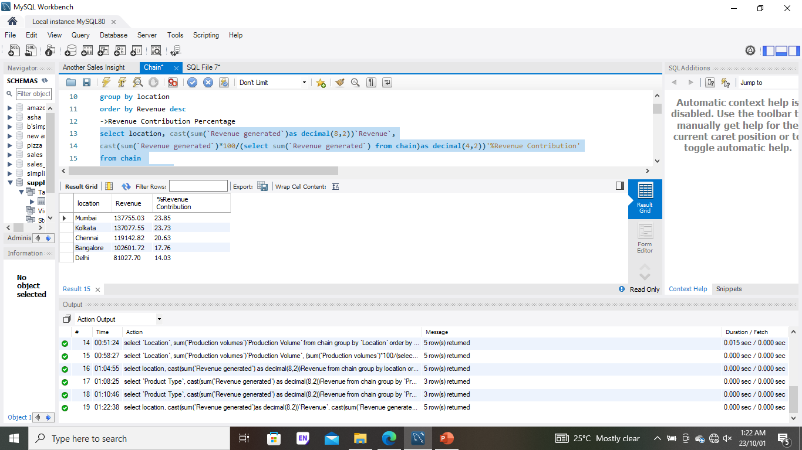

Slide 17
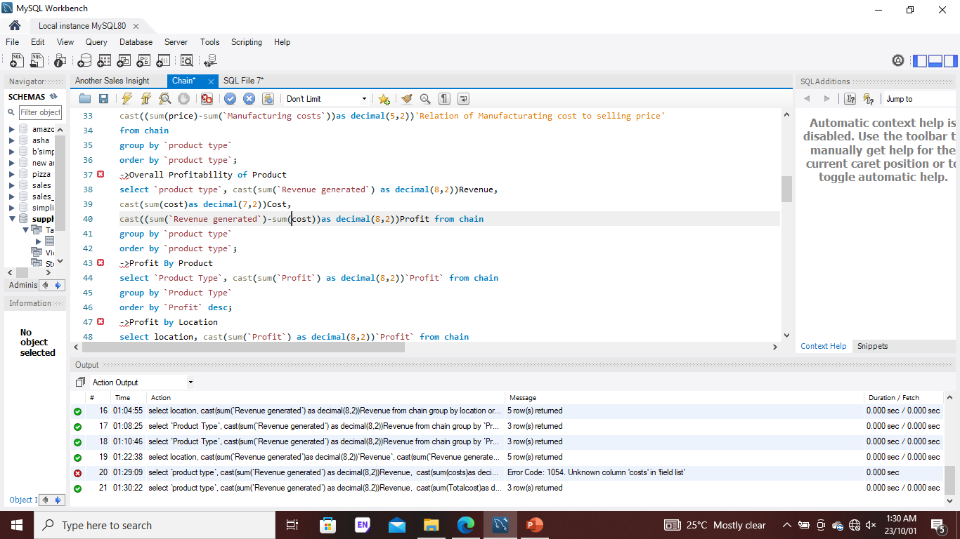
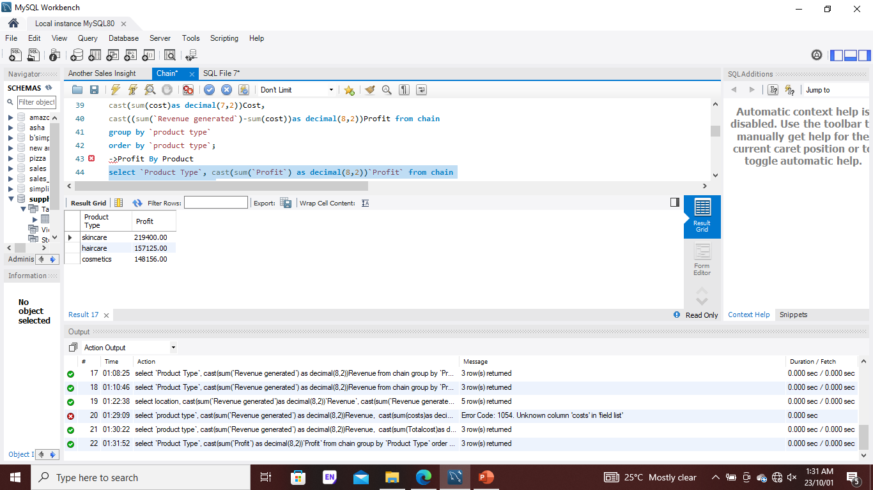

Slide 18
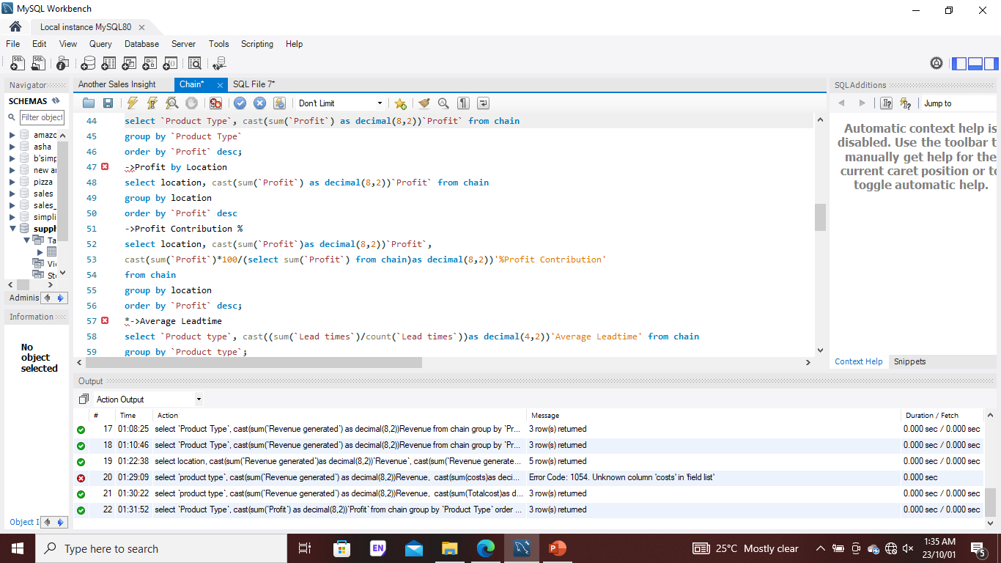
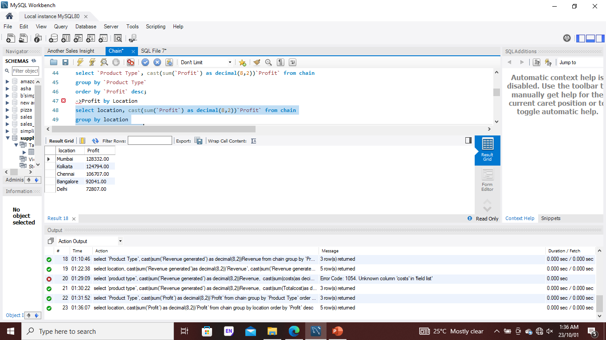

Slide 19
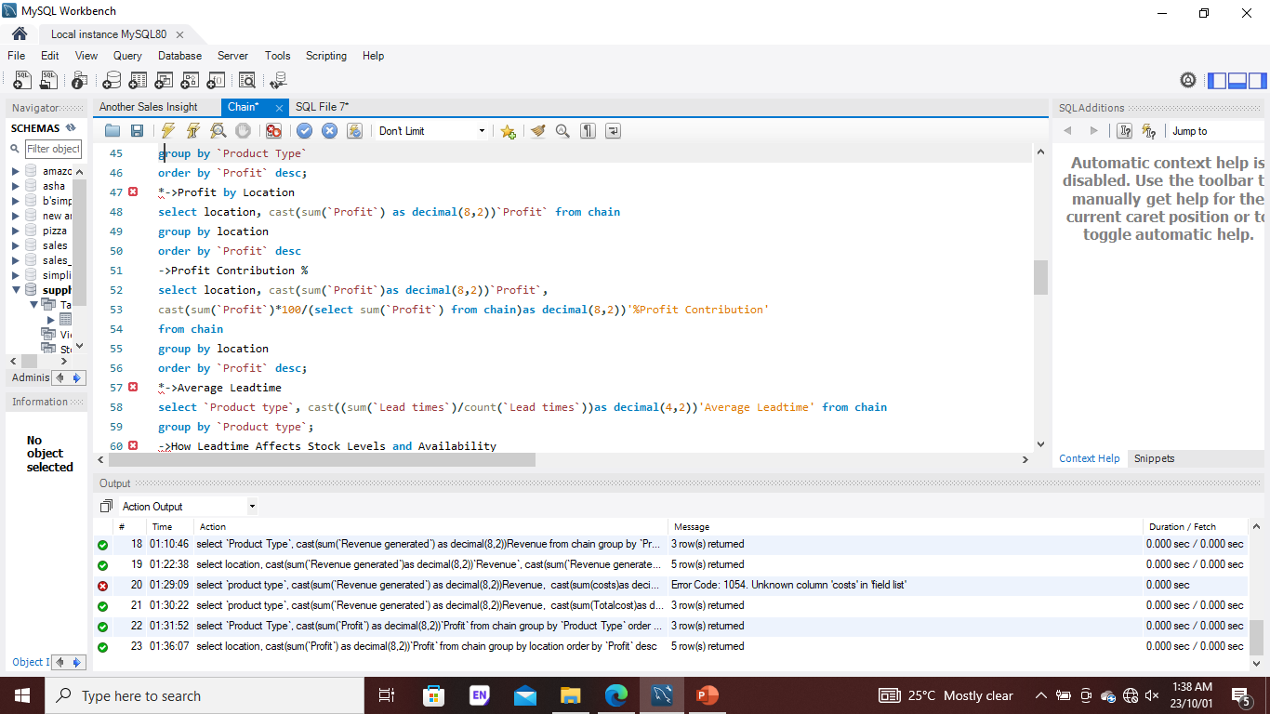


Slide 20

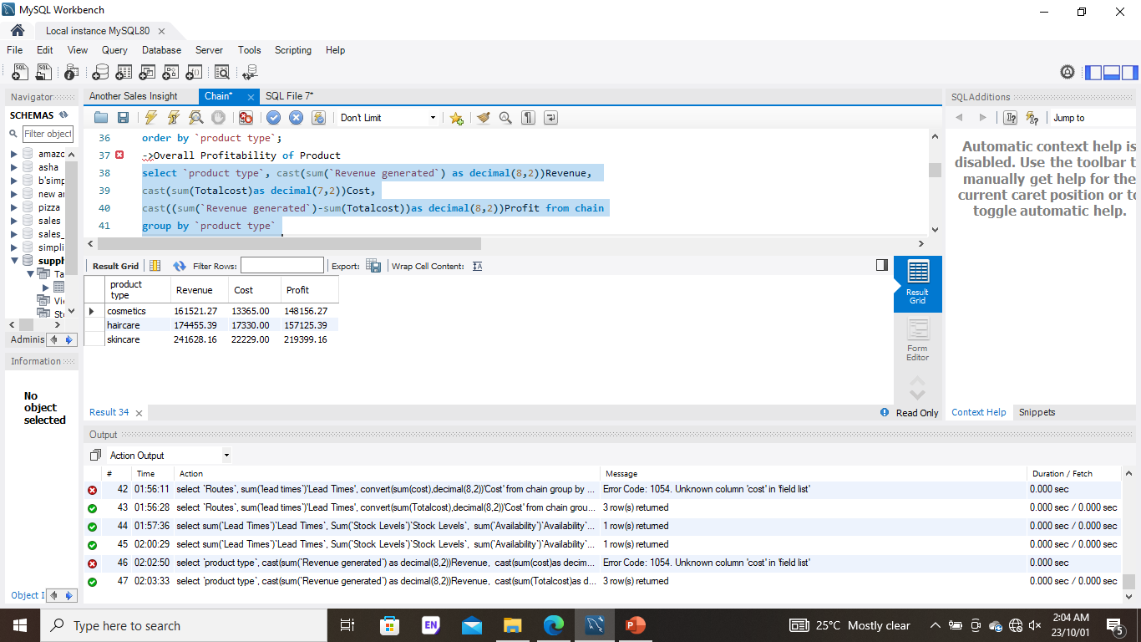

Slide 21
INSIGHTS
Skincare product and Mumbai (Location) generated more revenue at 241628.16 & 137755.03 respectively.
Availability & Stock Levels are higher than Lead Times at 4840, 4777 & 1596 respectively.
Kolkata, Chennai & Mumbai were the top three location with the highest number of orders.
Skincare is the costliest product to produce.
Relating manufacturing cost to price, haircare and skincare gave negative results -83.09 & -69.35.
Skincare and Haircare products generated more profit; were the top two highest.
Mumbai and Kolkata made more profit.
Based on Inspection result failed product had the highest manufacturing cost & percentage of defect rate.
Kolkata, Mumbai & Chennai were the top three location with the highest production volume.
Note: The currency used for variables like cost, profit, revenue, manufacturing cost are all in India Rupee (INR) ₹

